Slide 1



EBSN on EPALE: capacity building series
EPALE 2019 CONFERENCE, Belgrade, 15 October
Tamás Harangozó

Slide 2
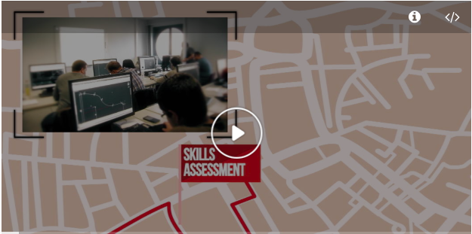

New Skills Agenda for Europe: Upskilling Pathways
Adults with skills needs
  In 2016, 63 million Europeans (25-64) low-qualified (lower than upper-secondary)
  Not eligible for Youth Guarantee support
  EQF level 3-4; employment; job security; social integration
(Link to the European Commission’s site on Upskilling Pathways)
Notes:
Policy orientation as a starting point: New Skills Agenda for Europe (Skills Guarantee) – 2016 EU Council’s recommendation on Upskilling Pathways!
2. Focus on adult basic skills! Data: 63 million (25-64 yrs)

Slide 3
New Skills Agenda for Europe: Upskilling Pathways
3-step approach:
  1. skills assessment
  2. tailored learning
  3. validation
Focus on basic skills: literacy, numeracy, digital skills
Partners:
  Ministries of Education and Labour
  Adult education centres
  VET centres
  Municipal authorities
  Knowledge/Competence cetres
  Public employment services
  Social partners
  Chambers & unions
Notes:
How to solve this? 3 steps: skills assessment – tailored learning – validation!
Not segmented, integrated!
Focus on basic skills (competences)
Partners in implementation of UP: ministries (ed. & labour); AE & VET centres; municipalities; learning & competence centres; PES; social partners; employee organisations – trade unions, chambers, etc.
GOAL: collaboration to escape fragmented efforts!

Slide 4



Background to the Capacity Building Series
WHAT?
OERs: Providing a curated collection of educational resources on EPALE directly linked to Upskilling Pathways
MOOCs: Reflective learning environment with experts’ support
WHO?
For policy-makers (national, regional, local, institutional); public employment services; VET and AE authorities; chambers; unions , etc.
HOW?
Capacity building through co-creation of knowledge
Supporting consultation & decision-making
Obtaining 3 open badges
Learning through 3 MOOCs
5 curated OERs
Reflective discussions
Notes:
CBS on EPALE
What is CBS
Why on EPALE? The profession is there...
WHAT? (curated, co-created resources for knowledge sharing): OER, MOOC, Online discussion, Collaborative space

Slide 5

WHAT IS THE DIFFERENCE: OER & MOOC?
MOOCs
Facilitated online course
Focus on interaction, networking, mutual learning
Motivate reflection
Active engagement
Different MOOC types:
Reflective
Co-constructed
Presence-based
OERs
Guided presentation of selected resources
Self-directed learning opportunity
Flexible accessibility

Slide 6
Capacity Building for Upskilling Pathways: OERs & MOOCs
Open Educational Resources
  Integrated Policy Approach in Basic Skills Provision
  Policies for the Linguistic Integration of Adult Migrants
  Building Inclusive Policies for Ensuring Digital Literacy and Skills
  Workplace Basic Skills: Policy and Practice
  Family Literacy Interventions: Policy and Practice
MOOCs
  Integrated Policy Approach in Basic Skills Provision
  Workplace Basic Skills: Policy and Practice
  Family Literacy Interventions: Policy and Practice
  Open Badges

Slide 7
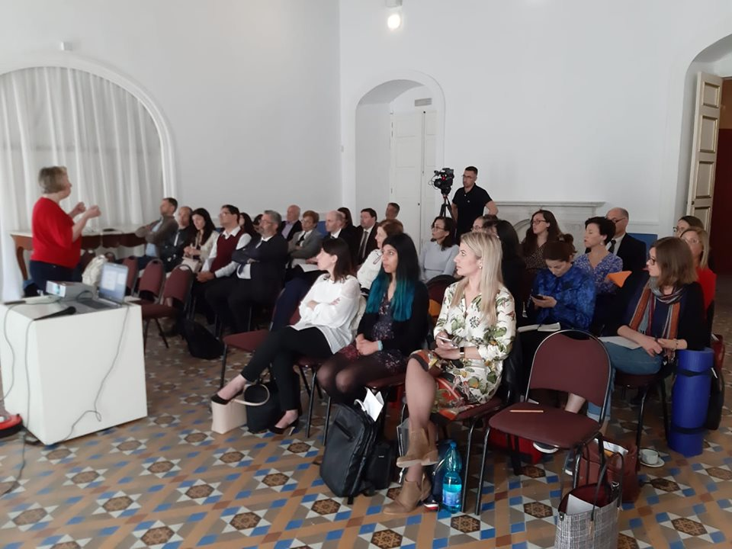
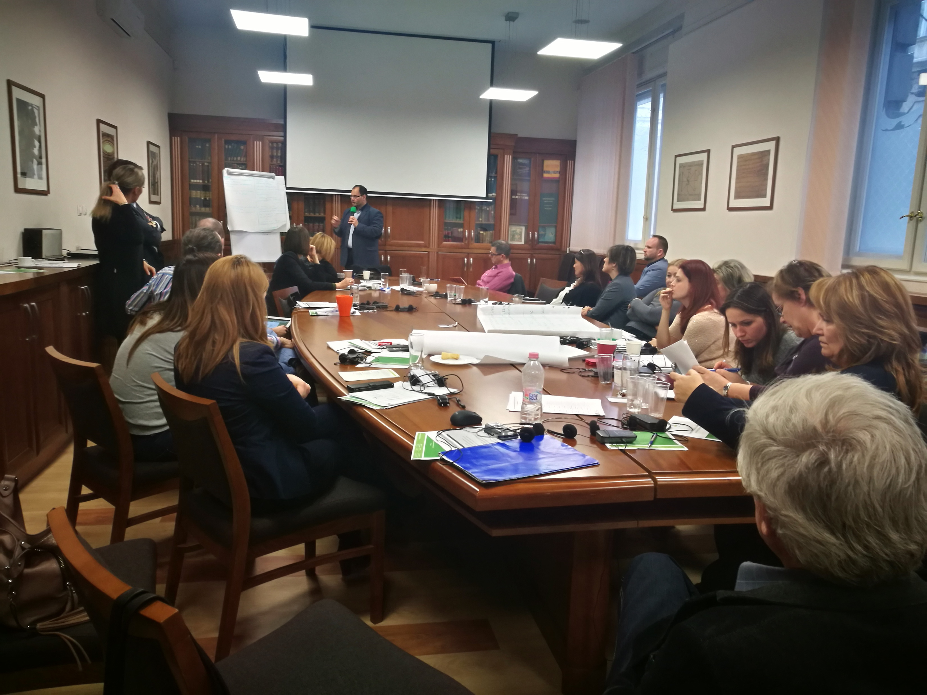
How to use the Capacity Building Series?
Online through EPALE!
Offline through...
  workshops in Member States to policy-makers: Hungary and Malta, Spain so far...
  professional events, conferences, support service)
Webinars in national languages (organised by NSS)
Awareness raising campaigns (Upskilling Pathways)
Notes:
MOOC Model:
Experimenting using third party platform
Very targeted, with very specific learning outcomes
Two types of MOOCs will be promoted
MOOCx: with presence-based learning
MOOCx: with individual learning pathways
MOOCc (or SPOC): Based on participative approach
EBSN CBS Badge

Slide 8
Get involved!
Contact us!
Tamás Harangozó
Editor for EBSN Capacity Building Series
ebsn-cbs-editor@basicskills.eu
Visit our website!
www.basicskills.eu

